Slide 1
Churn Prediction Analysis Report
Prepared By: Rishav Vashisht
Tools: Python, Scikit-learn, Pandas, Google Colab

Slide 2
Objective
To build a predictive model identifying high-risk churn customers, enabling proactive retention strategies.

Slide 3
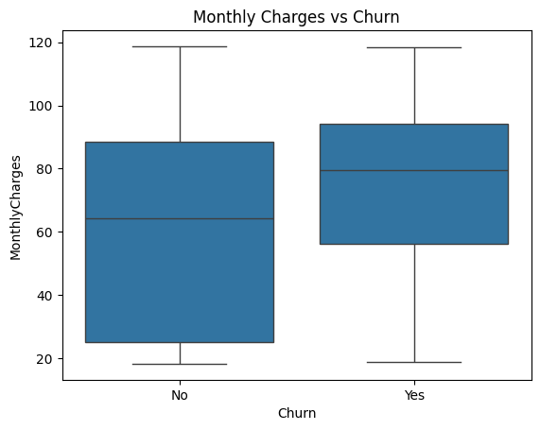
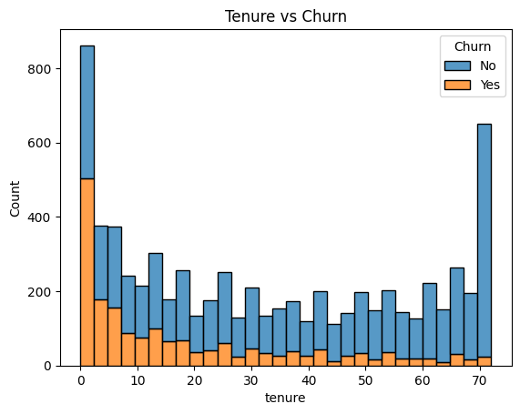
Dataset Overview
- 7,043 customer entries
- Features: Demographics, service details, behavior
- Target: 'Churn' (True/False)

Slide 4
Preprocessing
- Cleaned data
- Encoded categoricals
- Applied SMOTE for imbalance
- Train-test split (80/20)

Slide 5
Modeling Approach
Used Logistic Regression for interpretability. Compared with Random Forest for benchmarking. Applied SMOTE to balance classes.

Slide 6
Logistic Regression Results
- Precision (Churn): 63%
- Recall (Churn): 64%
- Accuracy: 81%
- F1 Score: 64%
- 240 true churners captured

Slide 7
Random Forest Benchmark
- Precision (Churn): 61%
- Recall (Churn): 57%
- Accuracy: 79%
- F1 Score: 59%

Slide 8
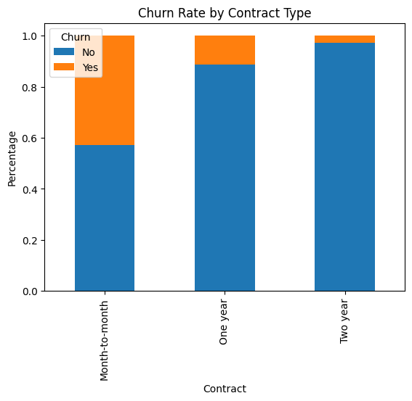
Key Drivers of Churn
- Low tenure
- Month-to-month contracts
- High monthly charges
- Electronic check payments
- Lack of bundled services

Slide 9
Business Impact
- Value per retained customer: ₹6,000
- True positives: 240
- Revenue saved: ₹14,40,000
- Cost (false positives): ₹70,000
- Net savings: ₹13,70,000

Slide 10
Recommendations
- Target low-tenure users
- Promote long-term contracts
- Monitor high-spenders with e-payments
- Use model monthly in CRM

Slide 11
Future Enhancements
- Try XGBoost, LightGBM
- Tune thresholds
- Add SHAP/LIME for explainability
- Build real-time dashboard

